Slide 1
GCSE Design & Technology: Electronic Products (4540)
Controlled Assessment Tasks and Guidance:
1st Section: Choice of Project and Investigating the Design Context

Slide 2
TIPS FOR A SUCCESSFUL FOLDER
Save your work to the Hard Drive (your documents folder) memory sticks are only there for transferring your work
Clear text and images, well laid out
Font size can be up to 12 point and no smaller than 8 point
The number of slides should be no more than 30
Pictures which appear small on screen will be ok in Slideshow
Don’t waste space you put pictures/graphics on you presentation that is relevant.
The content (depth/quality of work) is most important. You are given marks for grammar, comprehension and clarity
Save your work to the Hard Drive (your documents folder) memory sticks are only there for transferring your work

Slide 3
Setting up your Presentation
Set up your power point
Create a Front Cover with your Candidate Number on
Choose your task and title this on the front of your project
Save your work to two places

Slide 5
Context
Keeping property safe from theft has become a top priority in recent years.
Electronic products are used extensively to make property safe and secure.
Automated locks, sirens and flashing lights are used to deter and prevent
crime.
Design Task 2 – Electronic Alarm System
Design and make an electronic alarm system that is capable of being fitted to
a variety of doors, windows or property.

Slide 7
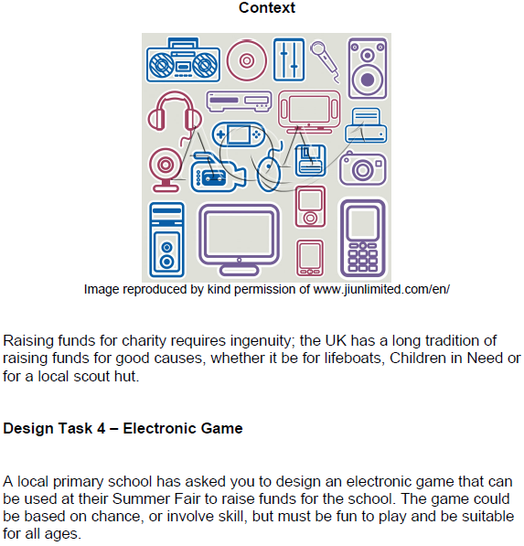

Slide 8
Context
Image reproduced by kind permission of www.jiunlimited.com/en/
Teaching children the value of money, and how to spend and save, is now
part of the school curriculum.
Design Task 5 – Money Box
A local bank wishes to encourage young children to save their pocketmoney.
You have been asked to design and make a novelty device which will make it
fun for children to use and save their money.

Slide 9
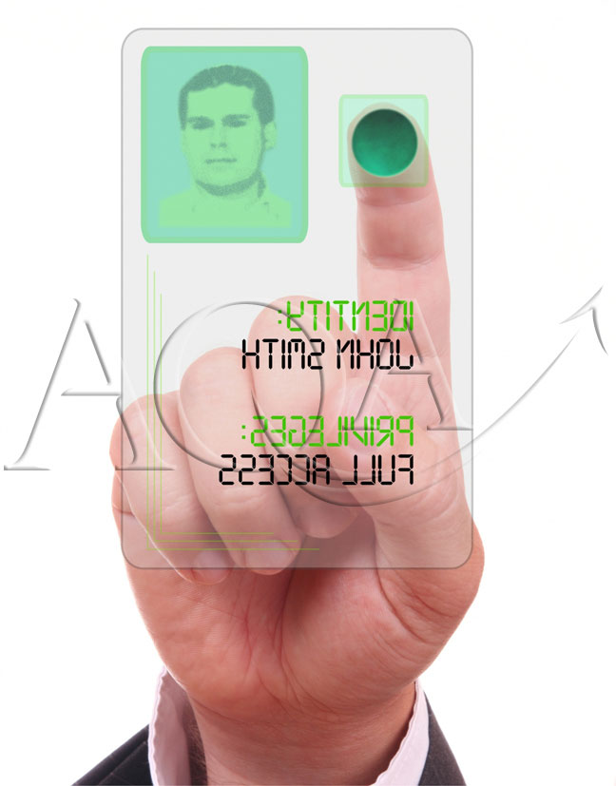
Context
Image reproduced by kind permission of www.jiunlimited.com/en/
“Use it or lose it” is a saying which is now frequently used in today’s world;
people find it useful to count and measure all sorts of activities in order to try
and give them a value, or measure their effectiveness.
Design Task 6 – Counting System
Design and make a system which will count and display activities that occur in
everyday situations, it could be people entering buildings, cars entering and
leaving a car park?; it could even be how quickly an activity takes to happen.
You will need to consider how many events you want to count and what type
of display you will use.

Slide 10
Context
Modern technologies based on music and communication play an important part in people’s lives today and can be used as strong personal statements.
Design Task 8 - Sound and Music
Design and make a product using sound or music. It could be a toy which plays a lullaby for the baby, an MP3 player dock, doorbell chime, an amplifier for ring tones, even a metronome - the product should reflect its application.

Slide 11
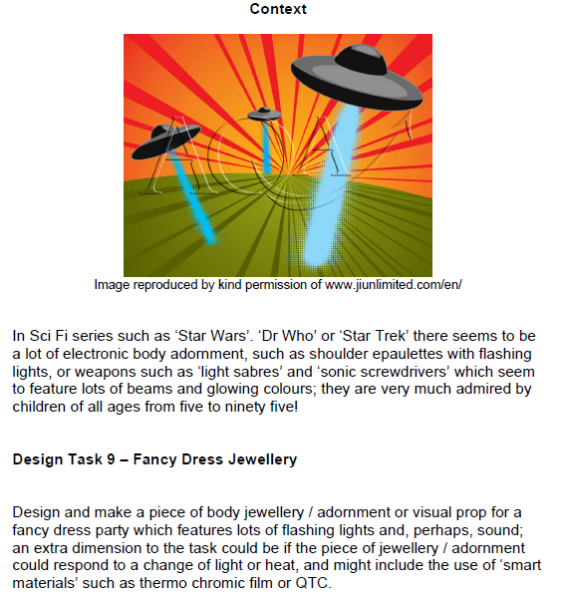

Slide 13
Planning the Project
In order to keep a check of the that time you are planning to spend on the project and which bits need more time than others, means you need to set out all the areas that you need to tackle in a logical sequence.
Gannt Charts are very useful for keeping you up to date with what you need to do throughout the Design and Make process.
 | Month | Jan | Feb | March | April | May | June | July | August | September | October | November | December
Task
Situation
Target Market
Brief
Analysis
Research
Systems diagram
Specification
Circuit Ideas
Chosen Circuit
Breadboard 1
Breadboard 2
PCB Development
Example Gannt Chart

Slide 14
The start of your project
Design Situation- Once you have chosen the task, you need to produce a Design Situation, which is the start point for your project.
The start point can be to overcome a particular problem or to improve a situation that already exists. It tends to be something that one person or lots of people could benefit from, e.g. Youngsters the disabled etc. Explain what the need/purpose for your project is and what it will be used for. Will it improve someone’s quality of life?
Example: Many children today are reluctant to save money. The existing ways leave children bored to save, therefore they don’t do it. If they can interact with something while saving their money this problem might be overcome.
Target Market- What group of people are you aiming your project at? Give an age range, gender– male or female, also spell out particular needs the user group may have- disability, any cultural needs, Health and Safety etc.
Example: my project is aimed at....
Design Brief- you now need to spell out a brief statement saying what you are hoping to do to solve your Design Situation. It is important that you keep your options open at this stage, don’t say what you will do only what you might do.
my project will be coloured Red and Yellow may limit you later, my project needs to be brightly coloured is better as you have room to change.
Example: I have been asked to design and make a money box. This must be fun and interactive so that the children will enjoy putting their money in the box to help them save.....
TIPS: Think about the layout of your text and you can include pictures of someone from your user group in the situation that you have set out today
PAGE 1 OF
YOUR FOLDER

Slide 15
Analysis of the Design Brief
Produce a brainstorm on bubbl.us to look at all the things you need to think about and any decisions you need to make. With this you need to identify problems that you need to solve.
Write a list of questions you need to ask/solve in order to make your finished project. At this stage not how you will solve them!!!
Now write a list of what you need to research and how you are going to do it.
(You can put the list into a table)
Possible Headings
What I Need to Research | How Will I Find Out the Information/ Carry Out the Research | How Long Will it Take
PAGE 2 OF
YOUR FOLDER

Slide 16
RESEARCH: INPUT/PROCESS & OUTPUT COMPONENTS
Possible Input Components/ Blocks
Component/ Block Name | Description if What it Does | In-Process-Out | Circuit Symbol
Push to make
555 mono stable
examples
Possible Process Components/ Blocks
Component/ Block Name | Description if What it Does | In-Process-Out | Circuit Symbol
Bipolar Transistor
4017 Counter
examples
Possible Output Components/ Blocks
Component/ Block Name | Description if What it Does | In-Process-Out | Circuit Symbol
LED
Relay
examples
PAGE 3&4 OF
YOUR FOLDER

Slide 17
Possible Input Components
Possible Process Components
Possible Output Components
Switches; slide, rocker, Push to Make, Push to Break, Reed, Rotary, Membrane,
555 monostable
Schmitt trigger
LDR
Thermistor
Moisture Sensor
Microphone
Opto-isolator
Transistor
Thyristor
FET
555 Astable
741 Op-amp
4017 counter
4026 counter
Logic Gates; AND OR NOT
PIC’s Programmable Interface Controllers
LED & FlashingLED
Bulb/Lamp
Bells
Sirens
Solenoids
Buzzer (pcb mounted)
Piezo Transducer
7 Segment display
Liquid Crystal Display
Speaker
Motor
Relays
Darlington Pairs

Slide 18
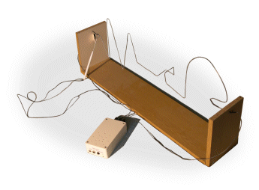
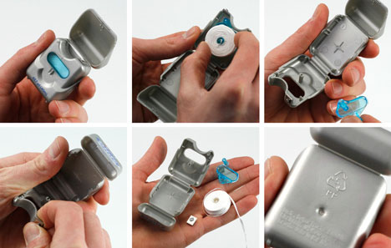
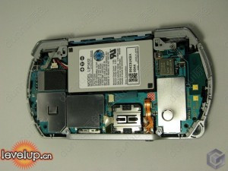
PRODUCT ANALYSIS AND DIS-ASSEMBLY
Annotate key points, What is good? What isn’t? Etc.
Annotate key points, What is good? What isn’t? Etc.
Annotate key points, What is good? What isn’t? Etc.
Annotate key points, What is good? What isn’t? Etc.
Analyse by looking back to your previous work; brain storm, user, brief, context etc.
Take battery-powered products apart and work out how they are assembled- thinking about your brainstorm/Brief etc.
Take battery-powered products apart and work out how they are assembled- thinking about your brainstorm/Brief etc.
Take battery-powered products apart and work out how they are assembled- thinking about your brainstorm/Brief etc.
Take battery-powered products apart and work out how they are assembled- thinking about your brainstorm/Brief etc.
Take battery-powered products apart and work out how they are assembled- thinking about your brainstorm/Brief etc.
Take battery-powered products apart and work out how they are assembled- thinking about your brainstorm/Brief etc.
PAGE 5 OF
YOUR FOLDER

Slide 19
KEY POINT: HOW YOU ARE GOING TO BE MARKED IN THE ANALYSIS SECTION OF YOUR COURSEWORK
Discrimination shown when selecting and acquiring relevant research that will promote originality in designing.
(WHICH MEANS THAT YOU MUST CARRY OUT YOUR OWN RESEARCH METHODS IN ORDER TO ANSWER THE QUESTIONS THAT NEED TO BE ANSWERED FOR YOU TO PRODUCE AN EXCELLENT COMPLETED PROJECT)
YOU NEED TO DO THIS TO RECEIVE TOP MARKS

Slide 20
QUESTIONNAIRE/SURVEY of the Target Market: RESULTS AND ANALYSIS
Q1 (e.g. what colours attract you to products)
Q2
Q3
Q6
Q4
Q5
Survey Analysis
Q7
Q8
Questionnaire Analysis
PAGE 6 OF
YOUR FOLDER

Slide 21
SYSTEMS ANALYSIS EXAMPLE
INPUT
PROCESS
OUTPUT
PTM
PIC
LED’S
TOUCH SENSOR
PIC
7 SEGMENT DISPLAY
TOUCH SENSOR
555-4017
TOUCH SENSOR
555-4017
LED’S
7 SEGMENT DISPLAY
TOUCH SENSOR
555-4017
7 SEGMENT DISPLAY
I/R TRANSMITTER RECEIVER
555-4026
TOUCH SENSOR
555-4026
LED’S
PTM
PIC
LED’S
TOUCH SENSOR
555-4026
7 SEGMENT DISPLAY
PTM
PIC
7 SEGMENT DISPLAY
I/R TRANSMITTER RECEIVER
PIC
LED’S
PTM
555-4017
LED’S
I/R TRANSMITTER RECEIVER
PIC
7 SEGMENT DISPLAY
PTM
555-4017
7 SEGMENT DISPLAY
I/R TRANSMITTER RECEIVER
555-4017
LED’S
PTM
555-4026
LED’S
I/R TRANSMITTER RECEIVER
555-4017
7 SEGMENT DISPLAY
PTM
555-4026
7 SEGMENT DISPLAY
I/R TRANSMITTER RECEIVER
555-4026
LED’S
TOUCH SENSOR
PIC
LED’S
I/R TRANSMITTER RECEIVER
555-4026
7 SEGMENT DISPLAY

Slide 22
INPUT
PROCESS
OUTPUT
PTM
THYRISTOR
DARLINGTON PAIR
BUZZER
REED SWITCH
555 ASTABLE
LAMP
MEMBRANE SWITCH
741 OP- AMP
PIEZO DISPLAY
555 MONOSTABLE
PIC
7 SEG DISPLAY
SCHMITT TRIGGER
4017 COUNTER
MOTOR
LDR
4026 COUNTER
LED
AND GATE
OR GATE
NOT GATE
TRANSISTOR
FET
SYSTEMS ANALYSIS

Slide 23
SYSTEMS ANALYSIS
INPUT
PROCESS
OUTPUT
Space for describing how this system works
Systems Analysis Tips
Try to think of the basics of each circuit component/block Input/Process/Output.
You could number each system.
You need to describe what each system does, what happens at the input, how the process block is affected by the input and how the output changes.
Can the output component be driven from the process block? Is there enough energy?
What in-between stages are needed
Space for describing how this system works
Space for describing how this system works
Space for describing how this system works
Space for describing how this system works
Space for describing how this system works
Space for describing how this system works
PAGE 7 OF
YOUR FOLDER

Slide 24
RESEARCH EVALUATION AND DESIGN SPECIFICATION
RESEARCH EVALUATION
DESIGN SPECIFICATION
My Project
MUST
--------------------------------
------------------------------------
---------------------------------
----------------------------------
-------------------------------------
----------------------------------
--------------------------------
SHOULD
-------------------------------------
-----------------------------------
------------------------------------
-------------------------------
----------------------------
-------------------------------------
COULD
-------------------------------------
----------------------------------
---------------------------------
------------------------------------
Evaluation of all relevant research
What your project; must be like/ do/ perform/ achieve!!
What your project; should be like/ do/ perform/ achieve!!
What your project; could be like/ do/ perform/ achieve!!
PAGE 8 OF
YOUR FOLDER

