Slide 1
GCSE Design & Technology: Electronic Products (4540)
Controlled Assessment Tasks and Guidance:
2nd Section: Development of Design Proposals (including modelling)

Slide 2
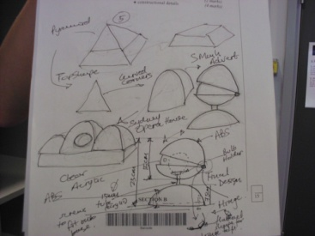
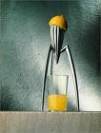
DESIGN INSPIRATION PAGE
ADVICE
This page is where you can develop your design ideas for the whole project by thinking creatively around the product.
Brainstorm ideas for the project by sketching out ideas, include Jack straws and Scruffiti to help to shape ideas.
Look at and highlight on this page of the coursework the work of these designers that inspires your design ideas for the whole project;
Marcel Breuer, Philippe Stark, Charles Rennie Mackintosh, Sir Norman Foster, Harry Ferguson, Alvar Aalto, James Dyson and Sir Trevor Bayliss.
PAGE 9 OF
YOUR FOLDER

Slide 3
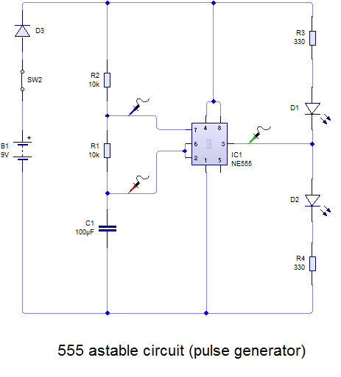
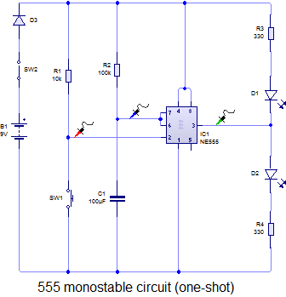
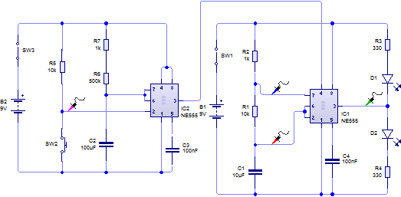
CIRCUIT DESIGN DEVELOPMENT PAGE 1
INPUT
PROCESS
OUTPUT
Annotate key points, what worked, what had to be changed and why Etc.
TIPS FOR FOLDER
You need to
clearly show your designs.
annotate the designs saying what you have done and why and any problems you overcame and how.
Break the circuit apart in to component parts
Include systems diagrams for the developed circuit.
include any relevant information such as graphs, formulae, chip connections etc.
Annotate key points, what worked, what had to be changed and why Etc.
COMBINED CIRCUIT
Annotate key points, what worked, what had to be changed and why Etc.
PAGE 10 OF
YOUR FOLDER

Slide 4
CIRCUIT DESIGN DEVELOPMENT PAGE 2
INPUT
PROCESS
OUTPUT
Annotate key points, what worked, what had to be changed and why Etc.
TIPS FOR FOLDER
You need to
clearly show your designs.
annotate the designs saying what you have done and why and any problems you overcame and how.
Break the circuit apart in to component parts
Include systems diagrams for the developed circuit.
include any relevant information such as graphs, formulae, chip connections etc.
Annotate key points, what worked, what had to be changed and why Etc.
COMBINED CIRCUIT
Annotate key points, what worked, what had to be changed and why Etc.
PAGE 11 OF
YOUR FOLDER

Slide 5
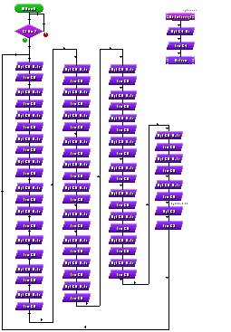
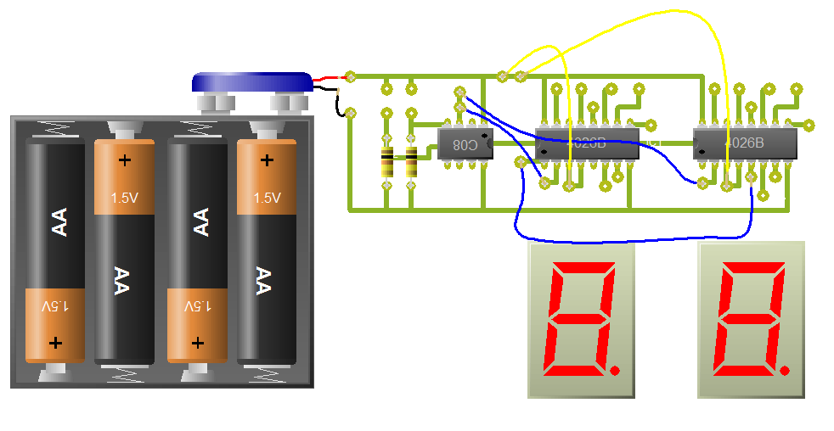
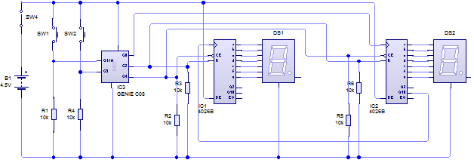
CIRCUIT DESIGN DEVELOPMENT PAGE 3
INPUT
PROCESS
OUTPUT
TIPS FOR FOLDER
You need to
clearly show your designs.
annotate the designs saying what you have done and why and any problems you overcame and how.
Break the circuit apart in to component parts
Include systems diagrams for the developed circuit.
include any relevant information such as FLOW CHARTS, CIRCUIT DIAGRAMS, graphs, formulae, chip connections etc.
Flow chart
Annotate key points, what worked, what had to be changed and why Etc.
Annotate key points, what worked, what had to be changed and why Etc.
PCB LAYOUT
COMPLETED PIC CIRCUIT
Annotate key points, what worked, what had to be changed and why Etc.
PAGE 12 OF
YOUR FOLDER

Slide 6
TASKS FOR THE COMPLETION OF THE DEVELOPMENT OF YOUR PROJECT
Chosen Circuit Diagram
Analysis of how it meets the Design Brief, Specification and
user needs and any problems that have needed overcoming
in the designing of the circuit.
Include any relevant information such as flow charts,
graphs, circuit formulae, chip connections etc.
Bread board of the chosen idea on computer (Circuit Wizard).
Bread board and testing of the circuit on a real life breadboard/
prototype board, include photographs.
Designing of the Printed Circuit Board layout on Circuit Wizard.
Three designs for the Project case, one using Google Sketch up,
which is free to download from the internet.
Further Research for how you will make the Project case, manufacturing methods and case materials
Evaluating implications of the case ideas looking at social, moral, economic, environmental and sustainability issues.
Chosen Circuit Design &
Circuit Development
PAGES 13–18 OF
YOUR FOLDER

Slide 7
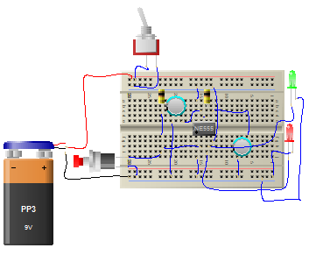
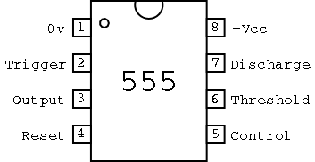
Circuit Diagram to Breadboard
Include annotation(descriptive sentenced labels) to describe the progress of your circuit.
Print off the circuit diagram to make the process easier.
Make sure you have all important information so that you can put the circuit together on breadboard.
Such as pin layouts.

Slide 8
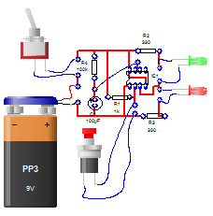
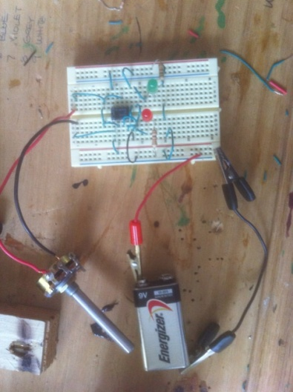
Devloping Your Chosen Circuit
Include annotation (descriptive labels) to describe the progress of your circuit.

Slide 9
Case Ideas 1,2 and 3.
Put pictures of your design ideas, cad work etc. on here, again evaluate with respect to the specification.

Slide 10
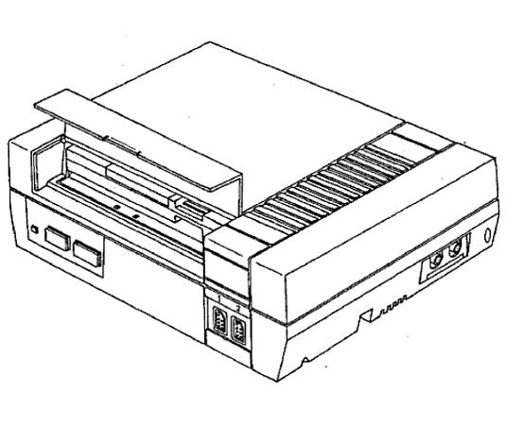
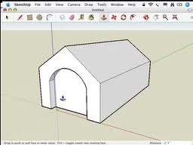
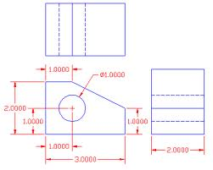
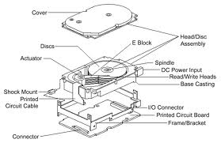
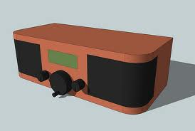
Chosen Case Idea/Working Drawing with Dimensions
This sheet can have lots of drawings of your chosen idea from different views; 2D and 3D drawing, an exploded drawing and a CAD drawing of your chosen case idea. You must include dimensions (sizes on your drawings).
Also you must include an evaluation stating how the product will be made, what materials are needed, the manufacturing methods and anything else that comes to mind.
3D
2D
Exploded Drawing
Google Sketch up CAD

Slide 11
Moral, Social and Environmental Considerations to do with the Product
ASKING SOCIAL QUESTIONS
Does the product make life better for people who use it in any way?
If it doesn’t, should we make it at all? If it does, who will benefit
and in what way?
Does the product make life better for the people who make it?
Do they get treated fairly in wages and work conditions?
Does the product encourage us to be sociable, to enjoy the
company of others when we want to?
Or does it encourage us to be more isolated?
Is the product appropriate for the age and/or gender group
at which it is targeted?
Does the product meet the needs of people today without limiting
the ability of future generations to meet their needs satisfactorily?
Are we “stealing from the future” by using up too many resources?
Does the product have positive or negative results for people living
elsewhere in the world, especially poor people?
Does the product take account of disability, e.g. sight, hearing,
physical? Can it be understood, read and used by those with
disabilities? Does it improve life for those with disability?
Does the way the product is made enable people
to enjoy their work?
ASKING CULTURAL QUESTIONS
Is any religious group likely to be offended by the product?
Is any ethnic group likely to be offended by the product?
Is the product likely to offend on the grounds of gender?
Is the product suitable for the age group at which
it is targeted?
Does the product encourage the maintenance of traditional
cultural values or traditions, e.g. festivals, dress?
Or might it mean the loss of some traditional values or skills,
e.g. home cooking?
Traditions can be regional, national or international.
Is the product appropriate for the society in which
it will be used?
Does the product encourage understanding of different values
and cultures?
ASKING ECONOMIC QUESTIONS
What’s the impact on jobs?
Will the product create them or reduce them?
Could the cost of production be cut down by reducing
the amount of material or energy used?
What types of jobs might be created?
Will they involve skilled, enjoyable work or not?
What are working conditions like for employees?
Do they get a fair wage and work in pleasant situations?
Where does sourcing and manufacture take place?
Does it encourage use of local materials and labour?
Does it provide opportunities for developing countries to
improve their standard of living?
Is making the product profitable?
If not, it cannot be sustainable.
Who gets the profit?
Does everyone get a fair deal or are some people
exploited?
Where does the money and financial help come from?
Could eco-friendly sources be used?

Slide 12
Plan Of Manufacture and Components List
PLAN OF MANUFACTURE
Step | Task | Links to spec’ | Tools to Use | Materials | Quality Control | Health and SafetySafet
1 | Mark out cut lines on copper pcb. | 1, 4, 8 | Try square, engineers rule. | Copper clad pcb | Accurate measuring, check with pcb on screen | N/A
2 | Cut pcb using guillotine. | 2,7,9,10 | PCB Guillotine. | Copper clad pcb | Line up with side bar. | Keep fingers away from cutting edge
3
4
CUTTING LISTS
Part | Material | Quantity | Cost
1
2
3

